Slide 1
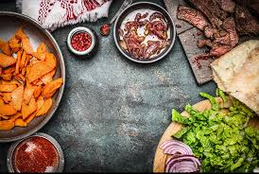
Individualized Nutrition
Presented By:
Shallyn’s Wellness Services

Slide 2
Disclaimer: I am not a nutritionist. I am not a dietician. I have a minor in Nutrition from Cornell University, I have been independently studying Blood Type Eating with Dr. D’Adamo for the past 20+ years and most recently Epigenetics with Dr. Ben Lynch, for the past 5 years. I am currently pursuing a PhD in Herbal Medicine through the School of Natural Healing. I have been a Physical Therapist for 20 years. I started my healthcare ministry full time in 2017 – shepherding people to complete health – body, mind, and spirit. I have a passion for helping you reach your ultimate active and well life through the love and power of Christ.
Individual results will vary.

Slide 3
Class Roadmap
Learn what your genetic code is telling you nutritionally.
Learn why knowing your blood type can optimize your food choices to feed your genes for healthy expression.
Learn B.A.S.I.C.S. living to optimize absorption of the nutrients you consume.
Take home recipes that will feed your type that you can cook from your pantry tonight.

Slide 4
Introduce Yourself – what brings you here today?

Slide 5
My Nutrition Story
7th grade health class – started with pain
My grandfather and USANA – good but manipulation to make a buck? Do I need all of these supplements?
Nutrition Minor
Blood Typing and exercise
Epigenetics, pulse method
Herbal Medicine
Individualization!
Next…?
Can you relate?

Slide 6
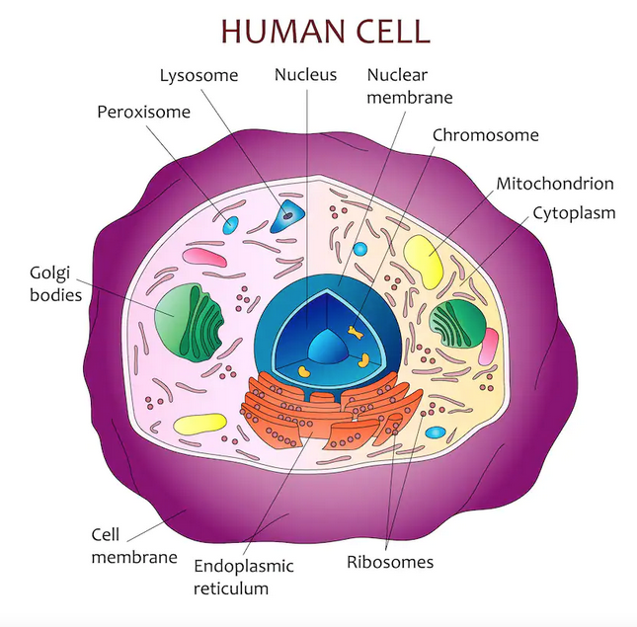
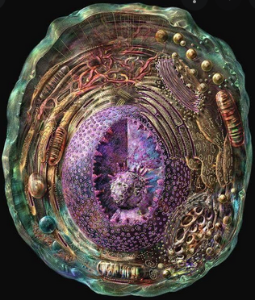
The Science Behind Individualized Nutrition: Epigenetics
Epigenetics –
The study of cell structures (organelles) around your DNA (found in the nucleus and mitochondria)
Turning them on and off for healthy expression
Some parts of a cell are involved in converting energy from nutrients in the food you eat into a form of energy that the cell can use. Other parts of the cell are involved in storing the genetic information that serves as the blueprint that makes you different from a gorilla or a hummingbird. Still other parts of a cell are responsible for building the proteins that enable the cell to do its many tasks.
Influenced by Behaviors and Environments
Reversible and do not change your DNA sequence BUT influences how your body reads your DNA sequence

Slide 7
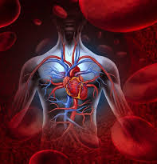
The Science Behind Individualized Nutrition: Blood Typing*
Blood Typing –
Started in 1996 by Dr. D’Adamo, Naturopath/Professor
2007 updated with GenoType diet (Epigenetics)
2017 Revised Blood Type
Blood Type interacts with the property of food to aid/hinder digestion

Slide 8
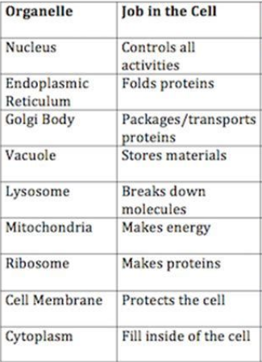
Blood Characteristics
RBC (glycoprotein) – binds O2, no nucleus, no organelles, no nuclear DNA
WBC -- +organelles, +nucleus, +nuclear DNA = responsible for our immune system
Platelets – no nucleus, responsible for blood clotting, results from fragments of large cells that are derived from stem cells in bone marrow, +mitochondrial DNA, secretes Serotonin which enhances vasoconstriction
Plasma
Cellular Respiration – O2 and glucose (energy) for nutrients in and CO2 out; manages pH regulation and thermoregulation
Essential for normal metabolic and immune system function

Slide 9
Common Problems Associated with Dirty Genes
Brain and Mood Issues
ADD/ADHD
Anxiety
Brain Fog
Depression
Fatigue
Insomnia and Sleep Problems
Irritability
Memory Problems
Cancer
Breast
Ovarian
Stomach
Cardiovascular Issues
Female Hormone Issues
Fertility and Pregnancy Issues
Gland and Organ Issues
Fatty Liver
Gallstones
SIBO
Thyroid
Metabolism Issues
Food cravings, especially sweets and carbs
Obesity and Weight Gain

Slide 10
Common Symptoms of Dirty Genes
Aching Joints/muscles
Acid Reflux/heartburn
Acne
Anger and aggression
Blood Sugar Spikes and crashes
Cold hands and feet
Bowel issues
Fibromyalgia
Food intolerance
Gas/bloating
Itchy skin
Obsessiveness
Overreactive startle reflex
Runny nose/congestion
Sweating
Workaholism

Slide 11
Which Genes are Dirty? Dirty Genes Questionnaire

Slide 12
Your genes are not your destiny! How you take care of them is.
“Act Dirty” (genetic expression)
Environment
Diet
Lifestyle
Mindset
“Born Dirty” (SNPs)

Slide 14
“Let Food be thy Medicine”-Hippocrates
Animal Protein vs Plant Protein vs Game Protein
Dairy Source (sheep/goat)
Gluten
Sugar (5-carbon vs 6-carbon)
Fruit…when
Organic vs non-organic
Tea/Coffee/Alcohol
Herbs…immunity, cardiovascular protection

Slide 15
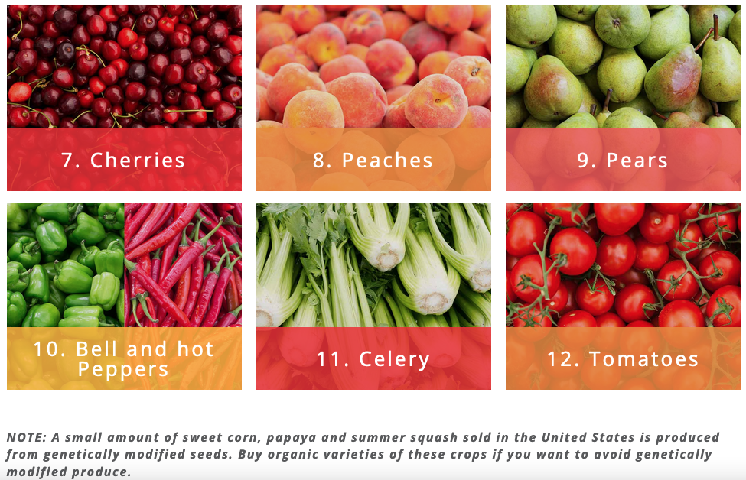
Organic Recommendations: “Dirty Dozen”

Slide 16
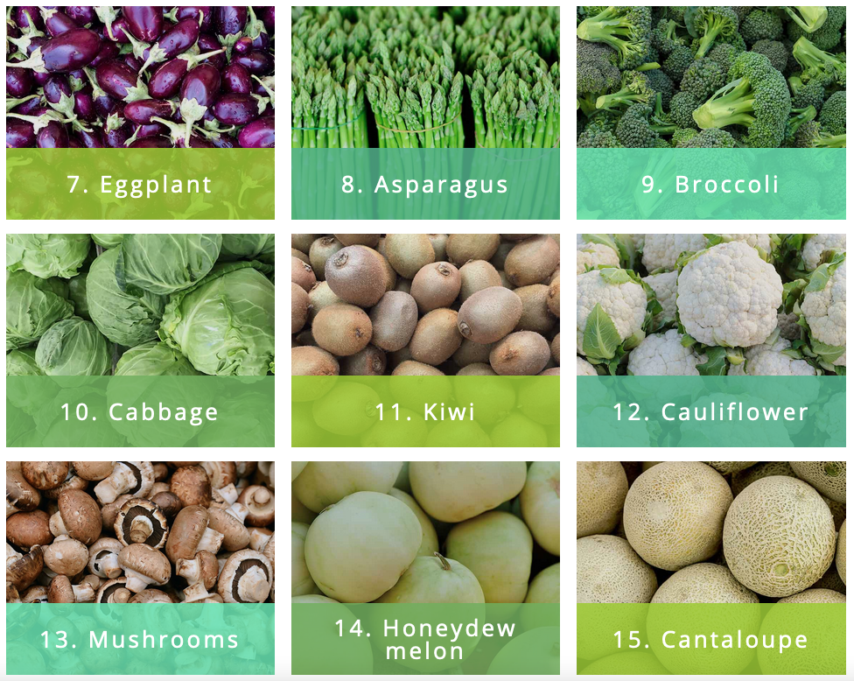
Non-Organic Options: “Clean 15”

Slide 18
Living B.A.S.I.C.S
Breathing
Focus on exhale – practice!
Away – get outside and move*
Stretch
If hypermobile, use dynamic stretching!
Identify top 3 things need to accomplish for the day
Consume water and food based on need
Sleep Hygiene
Screens, food, and time

Slide 19
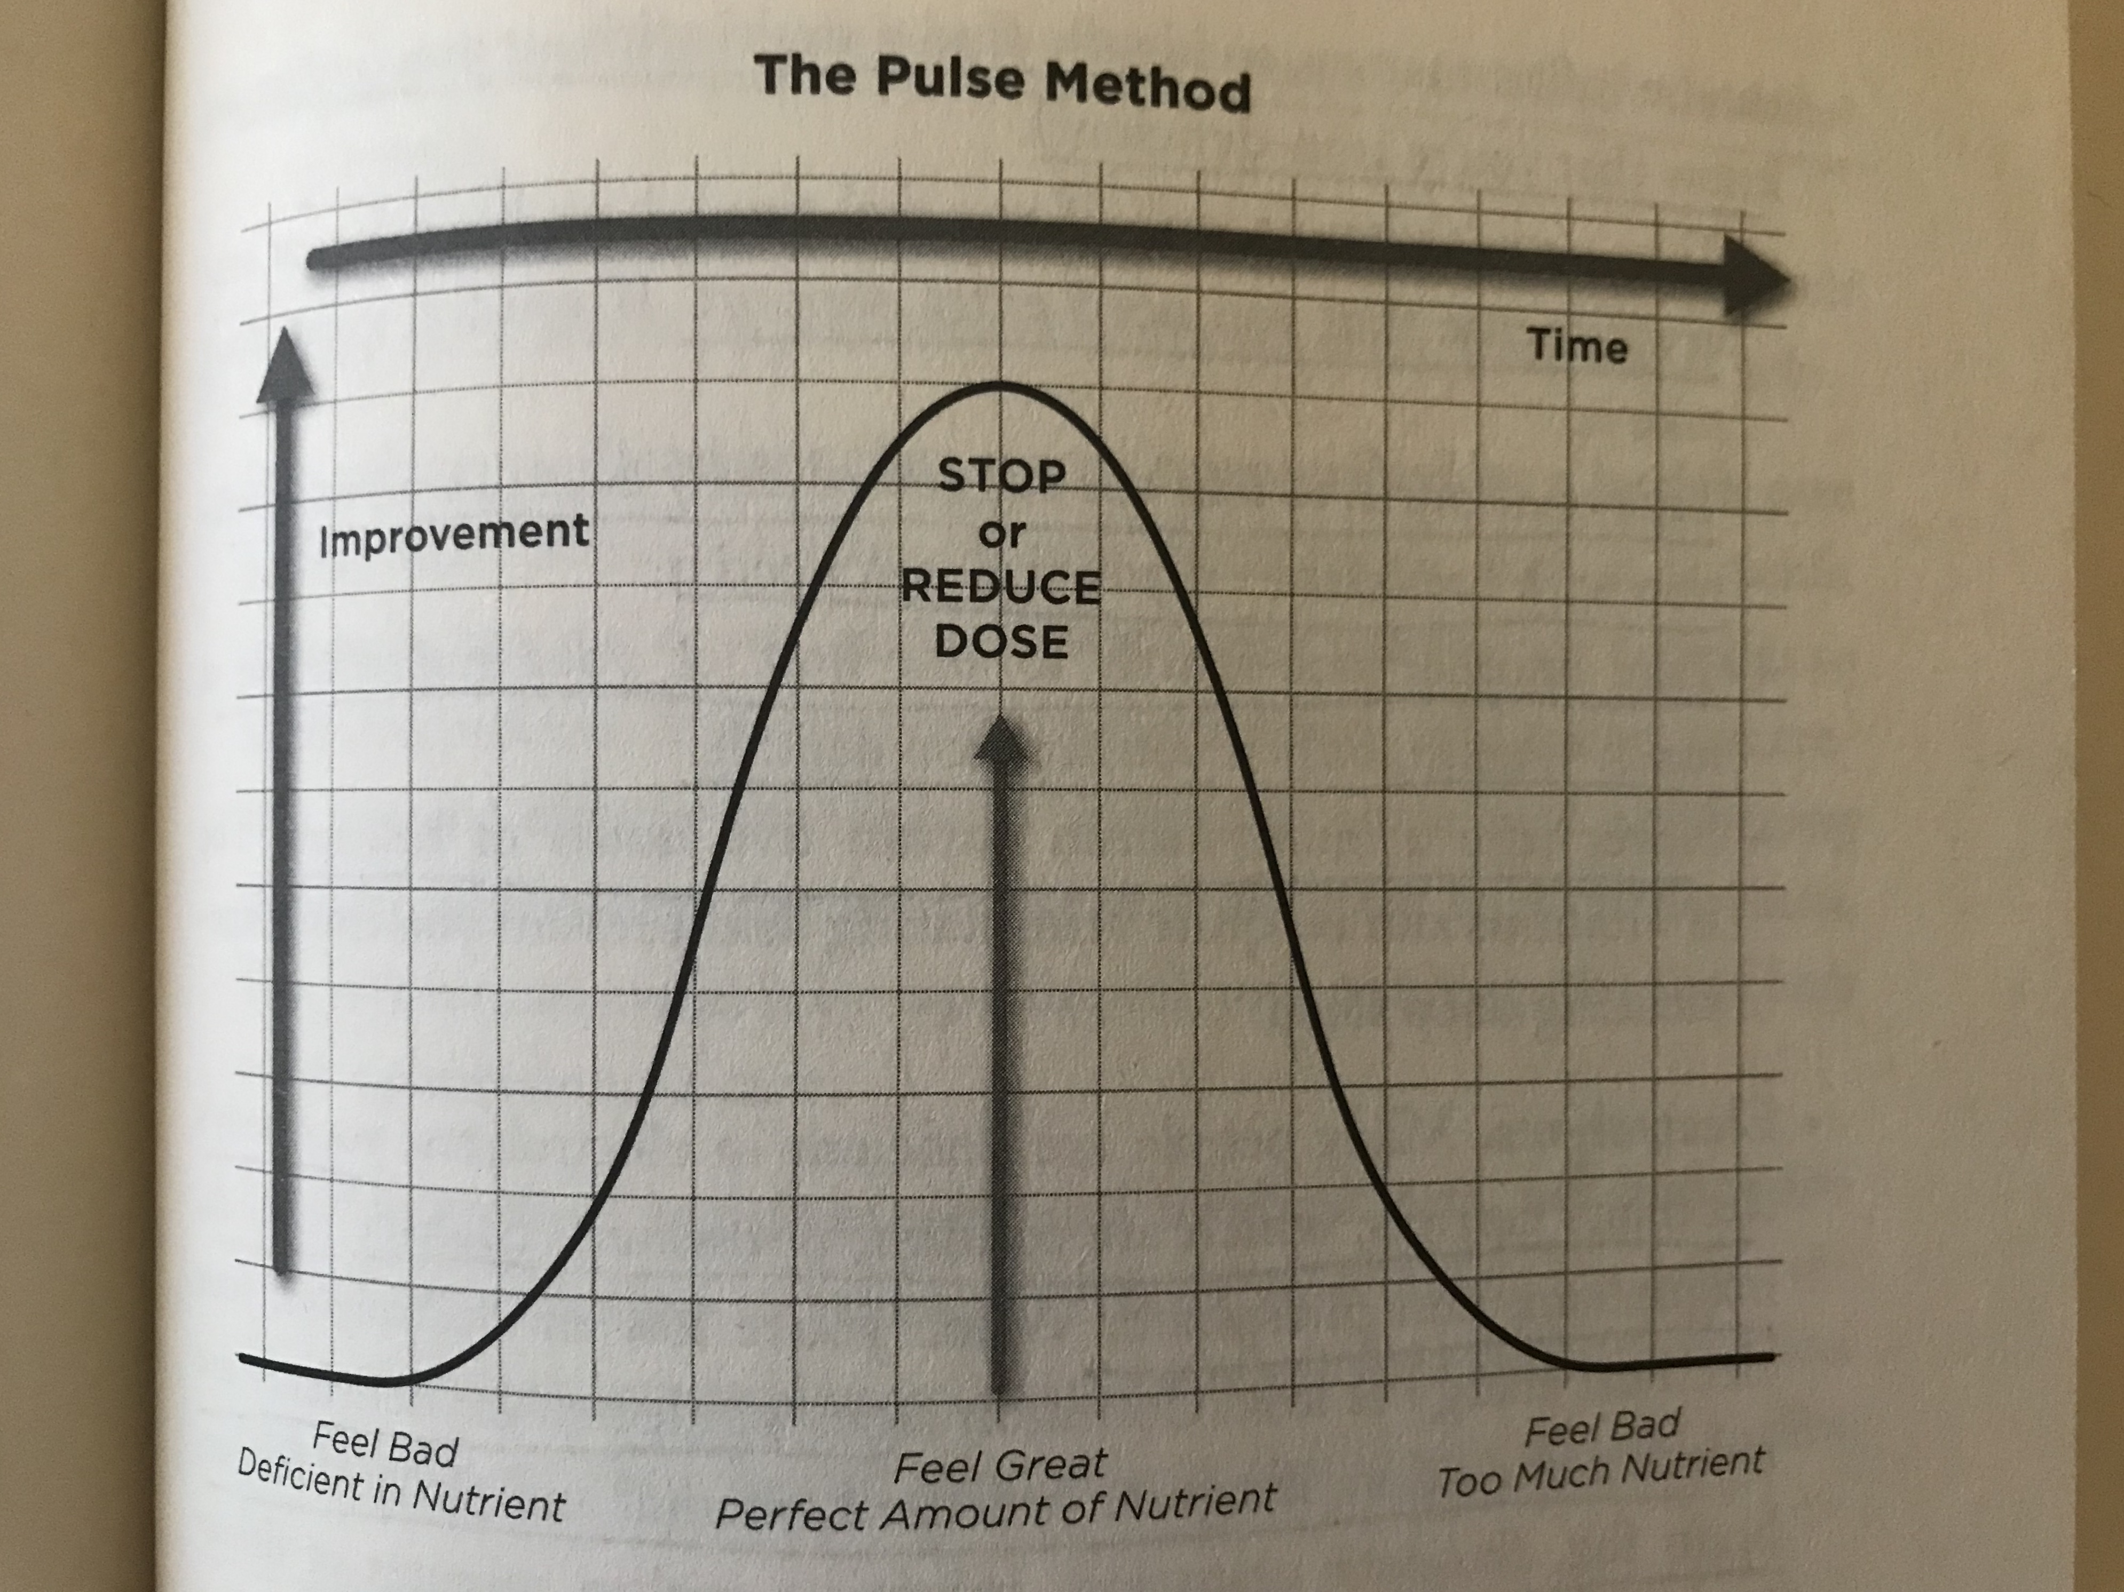
Pulse Method: nutrient do’s and don’ts
Learn to read
your symptoms!

Slide 20
Meet the 7 Dirty Genes that We Can Clean Up and Make the Most of for the Majority of our Cellular Processes

Slide 21
MTHFR
Primary Function: MTHFR initiates the Methylation Cycle which provides methyl to at least 200 functions in the body. Think of it as your breath of life to keep your cells functioning normally. 85% of methylation takes place in your liver, so support your liver!
Effects of a Dirty MTHFR: With Methylation Cycle disruption, you have dysfunction in antioxidant production (ability to fight disease), brain chemistry, cell repair (healing), detoxification, energy production, immune response, inflammation, and other crucial processes.
Signs of a Dirty MTHFR: anxiety, brain fog, chemical sensitivity, depression, irritability, and hair-trigger temper
Potential Strengths of MTHFR (when it’s ”clean”): alertness, decreased risk of colon cancer, stellar focus, good DNA repair, and productivity.
Methylation Master (“Breath of Life”)

Slide 22
Health Conditions Related to a Dirty MTHFR
Alzheimer’s
Asthma
Atherosclerosis
Autism
Bipolar
Bladder Cancer
Blood Clots
Breast Cancer
Chemical Sensitivity
Chronic Fatigue Syndrome
Down Syndrome
Epilepsy
Esophageal Squamous Cell Carcinoma
Fibromyalgia
Gastric Cancer
Glaucoma
Heart Murmurs
High Blood Pressure
Irritable Bowel Syndrome
Leukemia
Male Infertility
Methotrexate Toxicity
Migraines with Aura
MS
Heart Attack
Nitrous Oxide Toxicity (avoid or reduce alcohol consumption)
Parkinson’s
Pulmonary Embolisms
Schizophrenia
Stroke
Thyroid Cancer
Unexplained Neurological Disease
Vascular Dementia
Pregnancy- and Birth- related Complications
Cervical Dysplasia
Miscarriages
Placental Abruption
Postpartum Depression
Preeclampsia
Birth Defects
Anencephaly
Cleft Palate
Congenital Heart Defects
Hypospadias
Spina Bifida
Tongue-tie

Slide 23
What Makes MTHFR Dirty?
Inadequate methylated B9 (methylfolate) and methylated B12 (methylcobalamin), or vitamin B2 (Riboflavin)
Exposure to Industrial Chemicals
Psychological Stress
Physical Stress
Hypothyroidism
Folic Acid*
Limited Animal Protein (or supplement)
Antacid Use
H.Pylori
Pernicious Anemia

Slide 24
Examples of Common Healthy Methylation Cycles
Melatonin: comes from methylated serotonin to allow you to fall asleep.
Arsenic must be methylated to become inactive in your body and then is flushed out by the help of glutathione.
Histamine must be methylated in order to be flushed out of your body. Too much histamine can cause a chronic runny nose or insomnia (>7 micromoles/L). <7 you don’t have enough for methylation and glutathione production (which is necessary to expel arsenic from your body along with many other important functions we will learn about later).
Estrogen needs to be methylated in order to be expelled by your body. Without methylation you are more likely to experience PMS symptoms.

Slide 25
Key Nutrients for a Healthy MTHFR and Methylation Cycle
Riboflavin (B2): liver, lamb, mushrooms, spinach, almonds, wild salmon, eggs
Folate (B9): green vegetables, beans, peas, lentils, squash
Cobalamin (B12): red meat, salmon, clams, muscles, crab, eggs [*vegans/vegetarians have to supplement!]
Protein: animal sources = beef, lamb, fish, poultry, eggs, and dairy (many people have an intolerance to cow’s dairy products so, as long as you do not have an autoimmune disease, try goat and sheep products); plant sources = beans, peas, lentils, broccoli, nuts and seeds
Magnesium: dark leafy greens, nuts, seeds, fish, beans, avocados, whole grains

Slide 26
COMT: Focus and Buoyancy, or Mellowness and Calm

Slide 27
Purpose of COMT
Responsible for processing catechols, estrogen and some major neurotransmitters (dopamine (our body’s natural reward system), norepinephrine (noradrenalin) and epinephrine (adrenalin)).
Neurotransmitters enable us to process thought and emotion.
A Dirty slow COMT (processes these catechols, estrogen and neurotransmitters slowly): buoyancy, confidence, energy, enthusiasm, strong sexual function, estrogen issues (PMS, menstrual issues, fibroids, risk of female cancers), irritability, pain intolerance, sleep difficulties, trouble relaxing or powering down, workaholism, and sensitivity to caffeine, chocolate and green tea.
A Dirty fast COMT (processes these catechols, estrogen and neurotransmitters fast): excessive sense of calm, good-temperedness, lack of sleep difficulties, effective stress response, pain tolerance, difficulty completing tasks, difficulty focusing, forgetfulness, lack of confidence or optimism, low energy, menopause/perimenopause challenges, and reliance on caffeine, green tea or chocolate.

Slide 28
Health Conditions Related to a Dirty COMT
Slow COMT:
Acute coronary syndrome
ADD with hyperactivity
Anxiety
Bipolar disorder – esp. mania
Breast Cancer
Fibroids
Fibromyalgia
Panic Disorder
Parkinson’s
PMS
Preeclampsia
Schizophrenia
Stress Cardiomyopathy
Stress-related hypertension
Uterine Cancer
Fast COMT:
ADHD
Addictive Disorders
Depression
Learning Disability

Slide 29
What Makes COMT Dirty?
Slow COMT:
Low SAMe (hands off methyl groups to optimize methylation)
Low homocysteine levels
Excessive tea, coffee or chocolate
Too much stress (and thus too much stress neurotransmitters)
Excess weight or a diet high in animal fat, causing a build up of estrogen
Overexposure to xenoestrogens in plastics, personal care products, or home and garden products causing a build up of estrogen
Fast COMT: too much SAMe
Both:
Elevated homocysteine levels
Insufficient vital nutrients, especially folate/B9, cobalamin/B12, and magnesium
A born-clean MTHFR that’s acting dirty, or a born-dirty MTHFR that’s not getting enough support

Slide 30
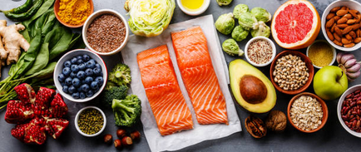
Key Nutrients for a Healthy COMT
To support Methylation which COMT relies on…
Riboflavin/B2
Folate/B9
Cobalamin/B12
Protein
Magnesium: dark leafy greens, nuts, seeds, fish, beans, avocados, and whole grains

Slide 31
Other Ways to Clean up Your Dirty COMT
Both:
optimize your weight (body fat creates estrogen)
Avoid plastics, including BPA plastics, because they mimic estrogen
Meditate a few minutes a day
Get up/go to bed at a fixed routine
Avoid Roundup (including soy products as they have likely been farmed with Roundup)
Avoid glyphosate, phthalates, and dioxins (esp. found in cosmetics)
Eat as clean as you can
Balance estrogen levels with beets, carrots, onions, artichokes, and cruciferous vegetables
Support your liver with dandelion greens and radishes
Eat a maximum of 3 balanced meals a day
Declutter your home
Slow:
Breathing
Music
Breaks
Exercise to sweat
Balance caffeine, tea and chocolate
Fast:
Increase protein, avoid sugar
Sleep
Brain engaging activities
Hug! (it raises dopamine)

Slide 32
DAO: Oversensitivity to Foods

Slide 33
Purpose of DAO
Our DAO gene is responsible for processing a biochemical called histamine; mostly outside of our cells mainly in our gut.
When it is dirty, we are more susceptible to neurological disorders, especially Parkinson’s Disease.
Oversensitivity to histamine, a biochemical that affects immune response and gut function. It also affects thought and emotion.
Identifying and eliminating gut pathogens is essential to overcoming a dirty DAO.
Commonly associated with leaky gut – a condition of the intestinal lining that allows partially digested matter into the blood stream, where it triggers an immune response – and poor digestion (low stomach acid, pancreatic enzymes and/or bile). This allows pathogens to flourish and raise histamine levels.

Slide 34
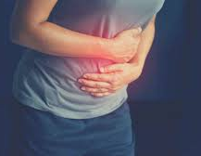
Health Conditions Related to a Dirty DAO
Anaphylaxis
Arrythmia
Asthma/exercise-induced asthma
Conjunctivitis or keratoconjunctivitis
Duodenal Ulcer
Eczema
Heartburn
Insomnia
Irritability
Irritable Bowel Disorders, including colon adenomas, Crohn’s Disease, and ulcerative colitis
Joint Pain
Mania
Nausea
Parkinson’s Disease
Pregnancy-related complications
Psoriasis
Vertigo

Slide 35
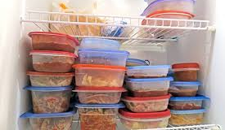
Avoid High-Histamine Foods and Drinks (including leftovers)
Aged cheeses
Alcohol (esp. champagne and red wine)
Bone Broth
Chocolate
Citrus Fruits and juices (except lemon)
Cured Meats (salami, some sausage, corned beef, pastrami, etc.)
Dried fruits
Fermented Foods (yogurt, sour cream, kefir, raw sauerkraut, kimchi, pickles, and fermented vegetables)
Fish, esp. smoked or canned and some fresh fish (esp. when raw, as in sushi)
Fruit juices
Soured foods (foods marinated in lemon or orange juice)
Raw tomatoes
Spinach
Vinegars (except unfiltered, organic apple cider vinegar)

Slide 36
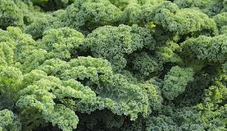
Key Nutrients for a Healthy DAO
Calcium: kale, broccoli, watercress, sprouted grains and beans, lower-histamine cheese (goat or sheep), bok choy, okra, almonds
Copper: beef liver, sunflower seeds, lentils, almonds, blackstrap molasses, asparagus, turnip greens
Foods that balance high acid or acid generating foods (see the following slide)

Slide 37
Foods that Balance High-Acid or Acid-Generating Foods
Almond Milk
Artichokes
Arugula
Asparagus
Avocado Oil
Beets
Bok Choy
Broccoli
Brussel Sprouts
Buckwheat
Cabbage
Carrots
Cauliflower
Celery
Chia Seeds
Coconut
Coconut Oil
Endive
Flax
Garlic
Ginger
Goat’s Milk
Grasses (wheatgrass, barley grass, alfalfa, and oatgrass)
Green Beans
Himalayan Salt
Kale
Kelp
Leeks
Mustard Greens
Okra
Onion
Peas
Quinoa
Rhubarb
Sea Vegetables
Sprouts of any kind
Watercress
Zucchini

Slide 38
Other Tidbits Surrounding a Dirty DAO
Certain medications can make DAO dirty – antacids, antibiotics, Metformin, and MAO inhibitors
Inflammation will create joint pain, brain fog, and fatigue (to name a few).
Avoid probiotics with Lactobacillus casei and Lactobacillus bulgaricus
Balance estrogen by avoiding plastics, optimizing your weight, eat more beets, carrots, onions, artichokes, dandelion greens, radishes, and cruciferous vegetables
Meditate
Use blue light filters
Avoid screens 1 hour before bed
Sleep in a dark room or use a good eye mask

Slide 39
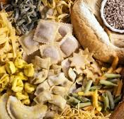
MAOA: Mood Swings and Carb Cravings

Slide 40
MAOA Function
Primary Function: produce MAOA enzyme which processes 2 key neurotransmitters – dopamine and norepinephrine – both which revs your body up for stress response and process Serotonin, a neurotransmitter that enables you to feel calm and optimistic.
A Dirty MAOA creates tremendous mood swings, making it difficult to control a temper and rise above irritating situations.
Slow MAOA: slowly expels these neurotransmitters, setting up for an abundance of them within your body. Fast MAOA = opposite.
Signs of a Dirty MAOA:
Slow: difficulty falling asleep, overactive startle reflex, headaches, irritability, mood swings, prolonged anxiety, rage/aggressive behavior, and trouble relaxing or powering down.
Fast: alcoholism or other addictions, ADHD, carb and sugar cravings, depression, difficulty staying asleep, fatigue and flat affect.
Potential Strengths:
Slow: when not stressed, more alert, attentive, cheerful, energetic, focused, productive and self-confident
Fast: when stressed, you have a greater ability to calm down; more relaxed and easy-going.

Slide 41
Serotonin Insight
When Serotonin is low we feel depressed, bleak, and helpless without much faith in ourselves or our abilities
Serotonin is needed for us to make melatonin
High Serotonin makes you feel anxious and irritable
To replenish Serotonin, you need Tryptophan which comes largely from carbohydrates (not the Thanksgiving turkey, as rumor has it).
Stress and inflammation push Tryptophan to make quinolinic acid, not Serotonin, which is very damaging to your brain.
Therefore, identify your stressors and manage them well and reduce inflammation that accompanies chronic disease.

Slide 42
What Makes MAOA Dirty?
Slow MAOA:
Too much Tryptophan (too many carbs…must learn balance)
Too little Riboflavin/Vit B2
Fast MAOA:
Too little Tryptophan (too little carbs…must learn balance)
Too much Riboflavin/B2
Both Types:
Too little glutathione
Chronic Stress
Physical Stress: Blood Sugar imbalance, Infection, Yeast overgrowth (Candida), SIBO, Leaky gut, Improper breathing
Emotional Stress
Chronic Inflammation:
From diet (excessive or wrong food types for your blood type; slow MAOA’s should eat light dinners)
From chronic stress; bringing stress levels down will also aid in abolishing cravings
From chronic conditions: obesity, cardiovascular disease, diabetes, autoimmune conditions, cancer

Slide 43
Health Conditions Related to a Dirty MAOA
Addictions
ADHD
Alzheimer’s
Narcissism/Sociopathy
Anxiety
Autism
Bipolar
Depression
Fibromyalgia
Irritable Bowel
Migraine
OCD
Panic Disorder
Parkinson’s
Schizophrenia
Seasonal Affective Disorder

Slide 44
Going Gray Early
If a dirty MAOA is under chronic stress, you deplete your neurotransmitters way too fast and increase your production of hydrogen peroxide.
Hydrogen Peroxide is removed by glutathione, our body’s prime detox compound.
Once glutathione is depleted (which is tough to make naturally in the body), hydrogen peroxide creates a toxic internal environment, expressing itself as going gray early (or white).
Too much hydrogen peroxide can create erratic moods, memory problems, irritability and aggression, ALS, Parkinson’s, Alzheimer’s

Slide 45
Key Nutrients for a Healthy MAOA
Riboflavin/B2: liver, lamb, mushrooms, spinach, almonds, wild salmon, eggs
Tryptophan: spinach, seaweed, mushrooms, pumpkin seeds, turnip greens, red lettuce, asparagus
Tryptophan is found in protein but not as well absorbed as Tryptophan from carbohydrates.
Our bodies always absorb fresh, whole food better than any other forms of nutrition.

Slide 46
GST/GPX: Detox Dilemmas

Slide 47
GST/GPX Main Role
Main role is to clear toxins from your system.
GST (found mostly in liver, gut and intestine) does this by attaching glutathione (the body’s chief detox agent) to xenobiotics enabling your body to pee out harmful environmental compounds. Therefore, when GST is dirty, you can not make this attachment and thus detox your body from harmful compounds.
Signs of a Dirty GST: hypersensitivity to chemicals (including runny nose, congestion, watery eyes, coughing, sneezing, fatigue, migraines, rashes, hives, digestive issues, anxiety, depression, and brain fog), increased inflammation, high blood pressure, and obesity.
Strengths of a Dirty GST: awareness makes you more motivated to maintain your health, and you respond more favorably to chemotherapy due to your body not being able to detox those compounds.
GPX does this by attaching glutathione to hydrogen peroxide (a by-product of the stress response) converting it to water to be peed out.
Excess Hydrogen Peroxide disrupts the Methylation Cycle and may demonstrate the following symptoms:
Early graying or white hair
Erratic moods
Chronic fatigue
Memory problems
Irritability
Aggression
Strengths include awareness to motivate health management

Slide 48
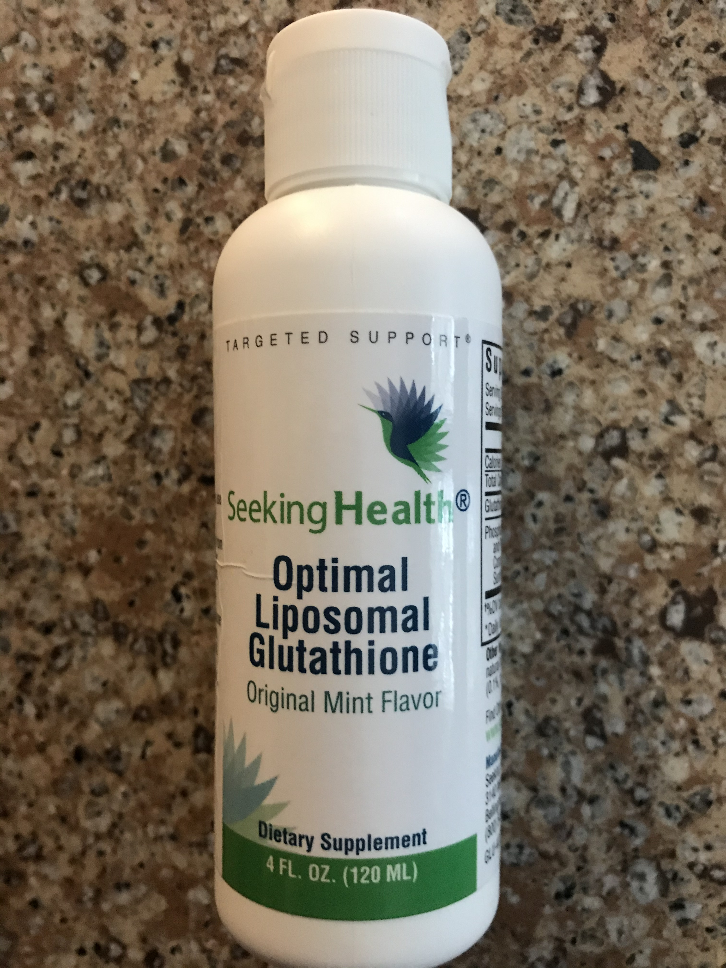
Glutathione (your primary antioxidant) Wonders
Carbs, high-fat foods, and sugar deplete glutathione therefore your body is limited in its ability to attach xenobiotics and hydrogen peroxide and detox yourself from these harmful chemicals. Therefore, take care of your microbiome!
Overeating produces an inflammatory compound called Methylglyoxal which glutathione converts into harmless lactic acid.
Glutathione glues B12 to its carriers proteins to get B12 into your cells which helps prevent anemia, provide oxygen to your cells, and prevent nerve damage.
Glutathione is necessary for your brain to make Dopamine and Serotonin.
Glutathione helps your body make nitric oxide which is essential for a healthy heart and blood vessels, and aids in fighting infection.

Slide 49
Health Conditions Related to a Dirty GST/GPX
Alzheimer’s
ALS
Anxiety
Autism
Autoimmune Conditions (Grave’s disease, Hashimoto’s thyroiditis, MS, RA)
Cancer
Chemical Sensitivity
Chronic Infections (hepatitis, mold reaction, Epstein-Barr, H. pylori, Lyme Disease)
Crohn’s Disease
Depression
Diabetes 1 and 2
Eczema
Fatigue
Fibromyalgia
Heart Disease
Hypertension
Hearing Loss
Homocystein surplus
Infertility
Keshan Disease (heart problem)
Mental Disorder (major depressive disorder, bipolar disorder, schizophrenia, OCD)
Migraine
Obesity
Parkinson’s
Pregnancy Complications
Psoriasis
Seizure
Stroke
Ulcerative Colitis
Vision Loss (progressive worsening)

Slide 50
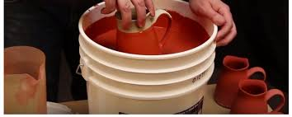
What Makes GST/GPX Dirty?
Exposure to industrial chemicals, heavy metals, bacterial toxins, and plastics.
Stress
Disrupted Methylation Cycle
Insufficient Riboflavin/B2 (which regenerates decaying, dysfunctional glutathione into whole, functional glutathione).
Insufficient Selenium: Selenium is needed for glutathione to attach to hydrogen peroxide to convert it to water to pee it out.
Insufficient Cystein: key ingredient in glutathione
Insufficient sulfur to make glutathione.
A build up of sulfites (SUOX gene uses molybdenum, a dietary mineral, to eliminate sulfites but can be stressed under a high-protein diet and/or high sulfur supplements) can lead to asthma.

Slide 51
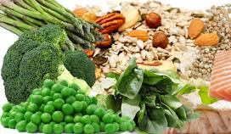
Key Nutrients for a Healthy GST/GPX
Cystein: red meat, sunflower seeds, chicken, turkey, eggs, broccoli, cabbage, cauliflower, asparagus, artichoke and onions
Riboflavin/B2: liver, lamb, mushrooms, spinach, almonds, wild salmon, eggs
Selenium: brazil nuts, tuna, halibut, sardines, beef, liver, chicken, brown rice, eggs

Slide 52
Other Key Items to keep your GST/GPX Healthy
Eat a lot of fiber (produces detox enzymes and binds to xenobiotics to eliminate toxins in your stool).
Clean up environment including mold
Sweat it out (at least 2 times a week): low heat sauna, Epsom salt bath, vigorous exercise, hot yoga, sex
Trust your sensitivity while others doubt it.
Grow broccoli and radish sprouts (3rd day after sprouting is most nutritionally potent)

Slide 53
NOS3: Heart Issues

Slide 54
NOS3 Main Purpose
Main purpose is to make Nitric Oxide, a substance needed to keep our blood vessels dilated.
Low nitric oxide makes blood platelets sticky which can form clots
Oxygen (proper breathing) will help keep your blood vessels dilated.
Signs of a Dirty NOS3:
Slow wound healing
Angina
Anxiety
Cold hands and feet
Depression
Heart attack
Erectile dysfunction
High blood pressure
Migraines
Mouth breathing may be associated nasal polyps, deviated septum, or tongue-tie
Sinus congestion/Runny nose can contribute to high blood pressure
Potential Strength of a Dirty NOS3: decreased blood vessel formation during cancer which slows the spread of cancer.

Slide 55
Depression as an Indicator of Heart Function
The NOS3 gene works hard to keep your heart and circulatory system healthy which impacts all organs served by the circulatory system.
Depression is associated with low levels of dopamine and serotonin.
Dopamine revs up your body to meet challenges and enables you to experience joy.
Serotonin supports your optimism, calm and self-confidence.

Slide 56
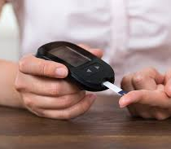
Diabetes and Heart Health
Insulin pushes NOS3 to make nitric oxide
With diabetes (insulin deficiency), NOS3 makes superoxide vs nitric oxide, which is one of the most dangerous free radicals there is.

Slide 57
Smoking and Heart Health
Nicotine causes BH4 to lower.
Without BH4, NOS3 can’t generate nitric oxide, but produces superoxide (that very dangerous free radical associated with diabetic complication).
Low BH4 results in reduced blood flow, sticky platelets, and greater risk of cardiovascular disease whether you are diabetic or not.

Slide 58
Nitroglycerin
Nitroglycerin (medication given to protect against acute heart attack) promotes the release of nitric oxide to support blood flow But sometimes it fails to work (when your NOS3 is dirty).
It does not work well in smokers as nicotine severely dirties up NOS3.
Nitroglycerin resistance can occur as well due to artificial means building up your nitric oxide vs natural means (thus, short term use of nitroglycerin is recommended over long term use).

Slide 59
Uncoupled NOS3
Uncoupled (non-functional) NOS3 can be caused by insufficient arginine (fuel) and BH4 (starter).
Arginine supports: blood vessel dilation, creatine formation, infection fighting, immune tolerance, neurotransmission, penile erection, reduction in platelet stickiness.
Certain types of bacteria in your microbiome also use a significant amount of arginine.
NOS3 needs arginine and BH4…so watch your microbiome.
BH4 is made using folate, magnesium, and zinc.
You can not get BH4 directly from food; you have to support your MTHFR so your body produces BH4.
Other causes of uncoupled (non-functional) NOS3:
A dirty MTHFR which increases homocysteine which increases ADMA (a component of blood plasma) that uncouples NOS3.
Elevated homocysteine and elevated ADMA = dementia.
A dirty GST/GPX decreases glutathione’s ability to remove xenobiotics and eliminate hydrogen peroxide which reduces BH4, uncoupling NOS3.
A dirty PEMT decreases your ability to maintain strong cell membranes which leads to inflammation which pulls arginine away which uncouples NOS3.
A dirty slow MAOA or dirty COMT increases stress which slows methylation and raises homocysteine which leads to increased ADMA which uncouples NOS3.
A dirty fast MAOA may increase hydrogen peroxide levels and thus reduce BH4 which uncouples NOS3.
Uncoupled NOS3 makes superoxide!

Slide 60
Folic Acid: Your Foe
Folic Acid is synthetic and our body was not designed to process it. We process it at great cost. Use folate instead.
Folic Acid is mostly found in enriched flours – breads and cereals.
NOS3 depends on compound called NADPH which folic acid also uses.
As folic acid increases, your BH4 decreases.
Excessive Folic Acid in pregnant women has been associated with congenital heart defects in the baby.

Slide 61
Pre and Post Menopause Association of Heart Health
Estrogen stimulates NOS3 to work better and produce nitric oxide
Post menopause, when estrogen drops, therefore the risk for cardiovascular disease in women increases.

Slide 62
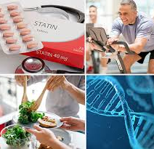
Be Wary of Statins
Statins do help stimulate the production of nitric oxide and support NOS3 (if it is clean!) BUT there are serious side effects:
Abdominal cramping or pain
Bloating
Constipation
Diarrhea
Dizziness
Drowsiness
Gas
Headache
Muscle ache, weakness or tenderness
Nausea or vomiting
Rash
Skin flushing
Sleep issues
Among the elderly, memory issues, mental confusion, increased blood sugar, and type 2 diabetes are common side effects of statins.

Slide 63
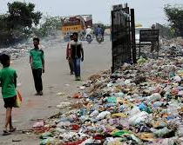
What Makes NOS3 Dirty?
Breathing abnormalities
Folic Acid
High Blood Sugar
High Carbohydrate Intake
High homocysteine levels
High insulin levels
Infection
Inflammation
Lack of movement – sitting, standing, lying down
Low antioxidants
Low arginine
Low BH4
Low estrogen
Low glutathione
Low oxygen
Microbiome imbalance
Mouth-breathing
Overeating
Oxidative stress (too many free radicals; including smoking and over exercising in the wrong exercise format for you*)
Poor methylation
Pollution
Sinus congestion
Sleep apnea
Smoking
Snoring
Stress
Tongue-tie

Slide 64
Health Conditions Related to a Dirty NOS3
Alzheimer’s
Angina
Asthma
Atherosclerosis
Bipolar Disorder
Brain Ischemia
Breast Cancer
Cardiovascular Disease
Carotid Artery Disease
Chronic Sinus Congestion
Coronary Artery Disease
Depression
Diabetes Type 1 and 2
Diabetic Nephropathy
Diabetic Retinopathy
Erectile Dysfunction (often an early sign of cardiovascular disease)
Hypertension
Left Ventricular Hypertrophy
Inflammation
Chronic Kidney Failure
Metabolic Syndrome (Syndrome X)
Recurrent miscarriage
Heart Attack
Neurological Disorders including ALS
Obesity
Preeclampsia
Prostate Cancer
Pulmonary Hypertension
Schizophrenia
Sleep Apnea
Snoring
Stroke

Slide 65
How to Support NOS3
You must do all 3 or none will work:
Supply adequate arginine
Maintain a steady supply of BH4
Clean your other genes.

Slide 66
Key Nutrients for a Healthy NOS3
Not from diet: BH4 (MTHFR support) and Glutathione (can supplement) and oxygen (proper breathing; moderate exercise).
Arginine: turkey breast, pork loin, chicken, pumpkin seeds, dairy products (but stick to goat or sheep milk), chickpeas and lentils.
Calcium: cheese, milk, and other dairy (but stick to goat and sheep milk products), dark leafy greens, bok choy, okra, broccoli, green beans, and almonds.
Iron: seeds from squash and pumpkin, chicken liver, oysters, mussels, clams, cashews, pine nuts, haxelnuts, almonds, beef, lamb, white beans, lentils, dark leafy greens
Riboflavin/B2: liver, lamb, mushrooms, spinach, almonds, wild salmon, eggs
Some natural nitrates: arugula, bacon, beets, celery, spinach

Slide 67
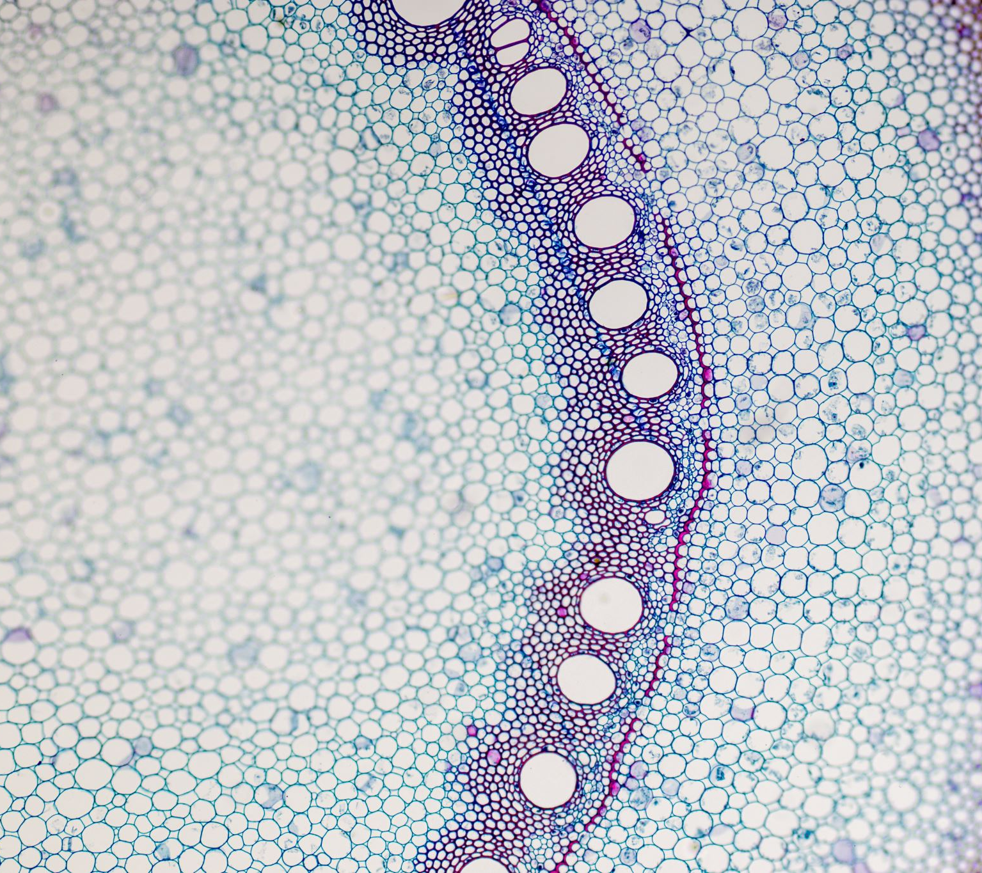
PEMT: Cell Membrane and Liver Problems

Slide 68
PEMT’s Role in Cell Membrane Function
The purpose of PEMT is to make phosphatidylcholine, a key ingredient in our cell membranes.
How many cells do we have in our body? (37.2 trillion)
Why is cell membrane function important?
Stiff, unhealthy and nonfunctional membranes prevent nutrients into your cells or transport harmful compounds out.
This is how you can be malnourished even if you’re eating a healthy diet or overweight.
We need a lot of choline to be converted to phosphatidylcholine by PEMT to protect these cell membranes.
Choline comes from meat, liver and eggs.
Without these sources in your diet, estrogen can act as a backup to provide PEMT a way to synthesize phosphatidylcholine.
Therefore, if you are male or a post menopausal female, you need to boost your choline in your diet to protect your cell membranes and your liver.
If you are vegetarian or vegan, you need to supplement choline!
There are some plant sources, but they are not as well absorbed as the animal sources.

Slide 69
Choline (Key Nutrient) Sources for a Healthy PEMT
Liver
Eggs
Chicken
Red Meat
Asparagus
Beets
Broccoli
Brussel Sprouts
Cauliflower
Flaxseed
Green Peas
Lentils
Mung Beans
Pinto Beans
Quinoa
Shitake Muschrooms
Spinach

Slide 70
The Role of Choline in Your Body
Supports liver function, nerve function, muscle movement, energy levels and metabolism.
Makes Acetylcholine, a brain neurotransmitter essential for learning and concentration.
Acts as a backup in the Methylation Cycle when you don’t have enough methylfolate (methylated vit B9) or methylcobalamin (methylated B12)
Too little folate means you use way more choline.
* When our body is low in choline, PEMT can also produce choline but then takes on both jobs (making choline and phosphatidylcholine), taxing itself to stay clean for your cells’ natural processes regarding cell membrane and liver care.

Slide 71
Fatty Liver
Exacerbated with high fructose corn syrup
Metabolic syndrome (including diabetes)
Obesity
Medications
PEMT and sufficient phosphatidylcholine moves triglycerides out of your liver via VLDLs (very low-density lipids); fatty liver is the build-up of these triglycerides (fat).
Mitochondria needs triglycerides as its fuel to detox your body. Without your triglycerides in your bloodstream, the mitochondria don’t have fuel to detox you. This builds up oxidative stress and stores your body’s fuel as fat, further damaging your mitochondria.

Slide 72
Apoptosis: the natural life cycle of a cell
The cells in your gut wall are completely replaced within less than a week.
RBCs live for about 4 months
WBCs live for 20 days
Skin cells are completely replaced every 2-3 weeks
If cells die faster than they are regenerated, infection and inflammation ensue
This can come from junk food, overexercise, and lack of nutrients
If cells are made quicker than they die off, this can lead to cancer and flourishing cancer.

Slide 73
Potential Strengths of a Dirty PEMT
Choline reservation for attention and focus.
Better response to chemotherapy.

Slide 74
Signs of a Dirty PEMT
Fatty liver: PEMT isn’t moving triglycerides out of your liver.
Muscle weakness, aches and pains associated with a chronic inflammatory state of your muscle cell membranes (chronic pain)
Brain fog
Fatigue
Gallbladder Disorders
Inflammation
Muscle Pain
Malnourishment; intolerant of fatty foods
Pregnancy Complication
SIBO (small intestine bacterial overgrowth)
Elevated triglycerides (high cholesterol)
Right shoulder tightness near your scapula.
Itchy
Chronic problems with constipation

Slide 75
Health Conditions Related to a Dirty PEMT
Birth Defects (esp. spina bifida – neural tube defects)
Breast Cancer
Depression
Fatigue
Fatty Liver
Gallstones
Liver Damage
Muscle Damage
Nutrient Deficiency inside your cells
SIBO

Slide 76
Life Seasons that Demand an Increase in Phosphatidylcholine and Other Phosphatidylcholine Wonders
Pregnancy (to ward off neural tube defects)
Breastfeeding (to promote cognition, support methylation, and make cell membranes in the growing baby)
Growing children
Phosphatydilcholine helps your bile flow smoothly out of your gall bladder to aid in digestion; keeping bacteria out of your small intestine.
Phosphatydilcholine is essential in nerve function, muscle movement, and brain development

Slide 77
Final Thoughts on Conservation of your PEMT gene
Stress management because stress burns through choline like rapid fire.
Chew thoroughly, eat while calm, don’t drink more than 8oz of liquid during a meal, avoid antacids, don’t drive and eat.
Eat leafy greens
Reduce refined carbs
Wash hands with natural soaps, not antibacterials
Cook with high smoke point oils (avocado oil, sunflower oil, or ghee) to reduce fatty acid oxidation. And turn on your exhaust fan while cooking.
Olive oil and coconut oils are low smoke point and should not be used in cooking but rather as salad dressing options etc.
Love your liver (85% methylation reactions occur in your liver) by limiting your alcohol intake, cut out preservatives and any unnecessary medications.
Consider visceral manipulation (manual draining) of your gall bladder if it is sluggish.

Slide 78
…and the cherry on top…herbal remedies
Immunity (A): Echinacea - garlic
Allergies: Chamomile, ginger
Arthritis: Alfalfa, Cherry, Slippery Elm, Yarrow
Bronchitis: Butcher’s Broom, Cherry
Cholesterol: Alfalfa, Dandelion, Skullcap
Chronic Fatigue: Licorice
Poor Circulation: Ginkgo
Cold Hands and Feet: Ginger, Gingko
Common Cold: Catnip, Cayenne, Cherry
Constipation: Cascara Sagrada, Psyllium
Coronary Heart Disease: Ginsengs, Hawthorn
Coughing: Cherry, Ginsengs
Depression: St John’s Wort
Diabetes: Ginsengs, Goldenseal
Diarrhea: Black Walnut
Dizziness: Ginsengs
Eczema: Goldenseal
Fear: Ginsengs
Headache: Ginger, Ginsengs, Feverfew
Heartburn: Ginsengs
Hip and Joint Problems: Slippery Elm
High Blood Pressure: Garlic, Ginsengs
Inflammation: Chamomile, Ginger, Yarrow
Influenza: Catnip, Cherry
Liver Problems: Dandelion, Milk Thistle
Nausea: Ginger, Ginsengs
Nervousness: Alfalfa, Catnip, Dandelion, Ginsengs, Valerian
Sore Throat: Bayberry
Stress: Kava Kava, Licorice, Skullcap, Valerian
Anti-viral Concoction: 3-5 garlic cloves, 1 Tbsp raw unfiltered honey, 1/8 tsp cayenne pepper

Slide 80
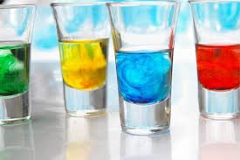
Lab Time: Let’s see how this works!

Slide 81
Thoughts? Individual Nutritional Counseling Packages
Follow-up on Dirty Gene Symptoms
Tweaks to Diet/Supplements/Herbs/Lifestyle
More Individualized Meal Planning

Slide 82
My Family Dirty Gene Success Story

Slide 83
…and what has this done for my clients
Better sleep
Better concentration
Improved energy
Cut food cravings
Controlled excessive sweating
Regulate digestion
Take away gut pain
Lose weight
Mitigate anger outbursts

Slide 84
Recap:
Genes/DNA = container
Blood = ice cream
Herbal Remedy Spot Cleaners = toppings
What is your ONE insight from this material?

Slide 85
(719) 219-5865 www.shallyns.com
Recipes in folder
Nutritional Coaching Packages – Contact me at (719) 219-5865 or visit my webpage at www.shallyns.com to register/send an inquiry.
Evaluation

Slide 86
References:
https://courses.lumenlearning.com/boundless-ap/chapter/overview-of-blood/
https://www.pinterest.com/pin/307089268342733473/
https://www.ck12.org/book/human-biology-lives-of-cells/section/3.1/
https://medlineplus.gov/genetics/understanding/basics/cell/
https://medlineplus.gov/genetics/understanding/basics/dna/
https://sciencing.com/neutralize-food-coloring-water-5845152.html
Dr. Ben Lynch: Dirty Genes
Dr. D’Adamo: Eat Right For Your Type
School of Natural Healing

